Slide 1

Predicting Virality with eXtreme Gradient Boosting on Online News Popularity Data
Ednalyn C. De Dios
Western Governors University
September 16, 2023
Notes:
What makes online content “go viral?” Is it the number of words, pictures, number of referral links, when an article is published, or the sentiment of words used?
Today, I’m going to take you on a journey. We will examine a thousands of articles and discover what makes them tick.

Slide 2

Ednalyn C. De Dios
Preferred Nickname: “Dd”
Machine Learning Engineer at Microsoft
US Navy Veteran
Notes:
Good morning! My name is Dd, two D’s no vowels.
I’m a US Navy veteran and I work at Microsoft as a Machine Learning Support Engineer.

Slide 3

5 Steps to Data Science Success
Planning
Getting the Data
Preparing the Data
Exploratory Data Analysis
Modeling
Notes:
Every successful data science project go through 5 general phases.
Namely,
Planning,
Data Acquisition,
Data Preparation,
Exploratory Data Analysis, and
Modeling

Slide 4

Planning
Notes:
In the Planning phase,
we review the business needs and come up with a research question and a basic plan to answer that question.

Slide 5


Notes:
For this study,
I selected Python and Jupyter Notebook.
I chose Python for it’s easy-to-understand syntax and versatility. While I chose Jupyter for its interactive nature and markdown capability.

Slide 6

Can gradient boosting be constructed based solely on the Online News Popularity Data?
H₀ : Gradient boosting cannot be made from the Online News Popularity dataset.
H₁ : Gradient boosting can be made from the Online News Popularity dataset.
Notes:
Our research question is whether gradient boosting can be constructed based solely on the Online News Popularity Data.
Our null hypothesis is that it cannot, and our alternate hypothesis is that it can be.

Slide 7
Getting the Data
Notes:
Now, let’s talk about our data.

Slide 8

Online News Popularity
39,979 rows
61 columns
Mashable.com
Notes:
I acquired the dataset from the UC Irvine Machine Learning Repository project.
It’s called the Online News Popularity dataset and has 39,797 rows and 61 columns.
It contains articles published at Mashable.com

Slide 9
Preparing the Data
Notes:
The preparation phase is simple straight-forward because the dataset is relatively clean.

Slide 10

Check for missing values
Correct the column names
Drop duplicate entries
Create the target variable
Remove outliers
Notes:
The dataset
Has no missing values nor duplicates
The column names needed a little bit of cleaning though
To prepare the data, I had to
Create the target variable using the threshold of 1400
Remove outliers

Slide 11
Exploratory Data Analysis
Notes:
The real fun begins at at the exploratory data analysis where we uncovered a few interesting facts.

Slide 12
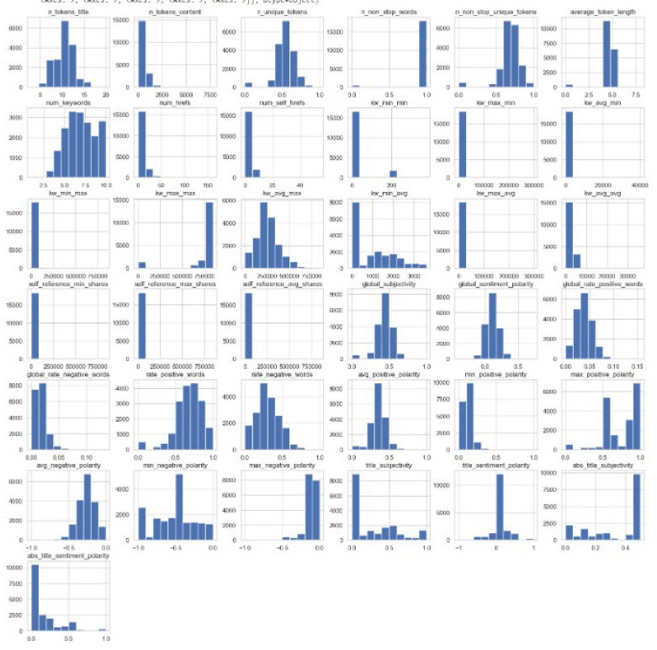
Notes:
First, all the variables that we’re numbers did not have a bell curve. This means that we cannot use certain algorithms that requires a normal distribution of the data. Normal distribution is just a fancy way of saying that it has a pretty uniform bell curve.

Slide 13
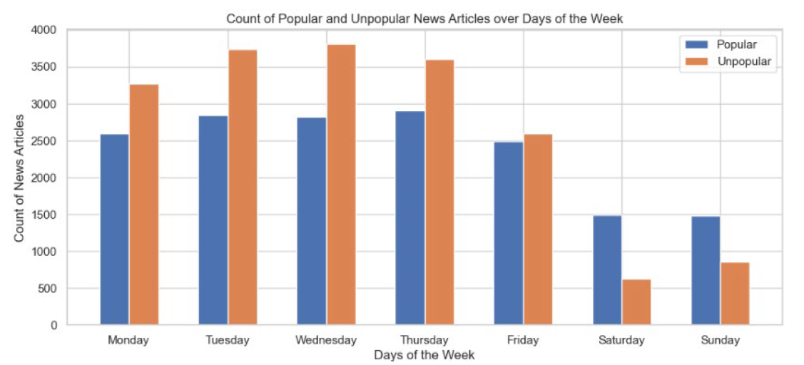
Notes:
This slide shows the count of popular versus unpopular news articles over days of the week.
In this graph, it is evident that weekends are a slow news cycle.
Furthermore, during the week, articles are more likely to be unpopular than popular. However, this flips on the weekend where articles are more like to go viral than not.

Slide 14
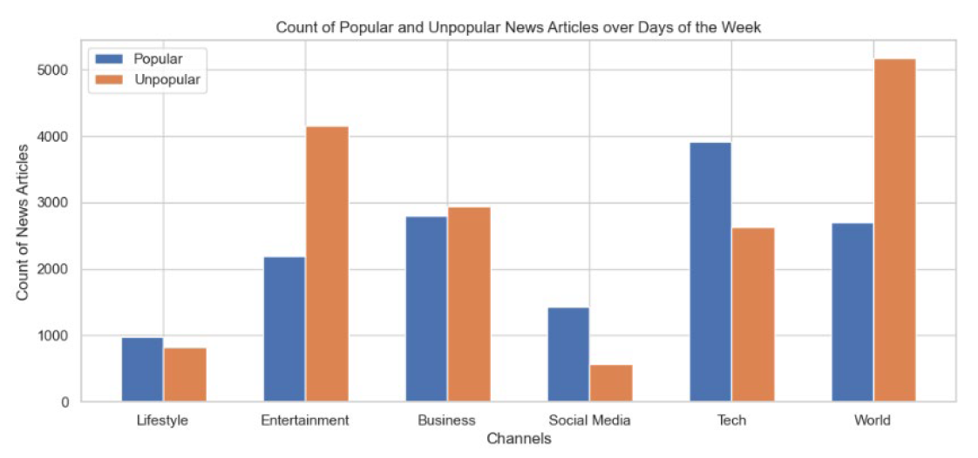
Popular Vs. Unpopular Channels
Notes:
In this graph,
We can see that articles in the Social Media and Tech channels are more likely to be popular than not.
Perhaps, this is because of the niched demographic of Mashable’s customer base.

Slide 15
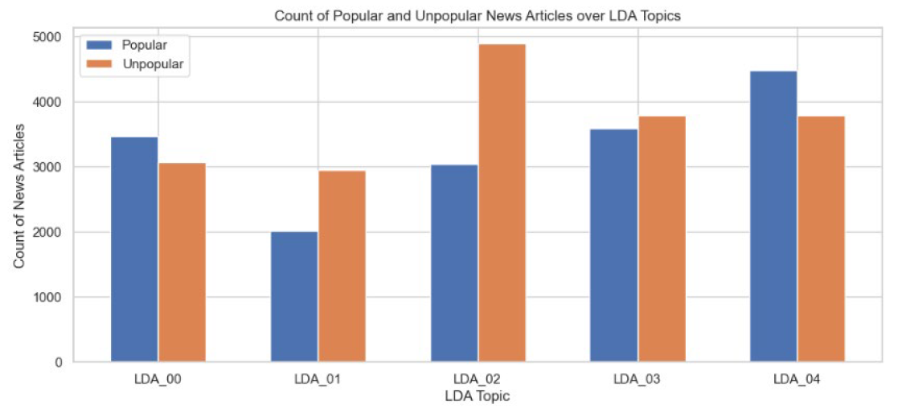
Notes:
And lastly,
As shown in this graph of LDA Topics, LDA #2 have a greater number of unpopular articles than other LDA topics.

Slide 16
Modeling
Notes:
Now, the fun continues in the modeling phase.

Slide 17
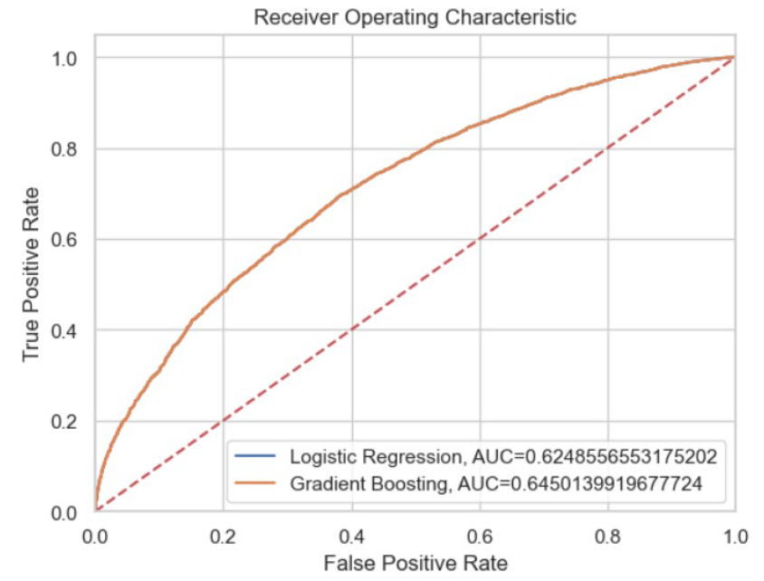
Notes:
We created several models but only selected the best ones. In this study, the result ROC curve of the logistic regression and XGBoost were so close that you can’t even tell the difference when visually inspecting the graph.
After all is said and done, the accuracy of the final model is 66% with an AUC score of 65%. This validates our alternate hypothesis that a gradient boosting model can be built using the Online News Popularity dataset.

Slide 18
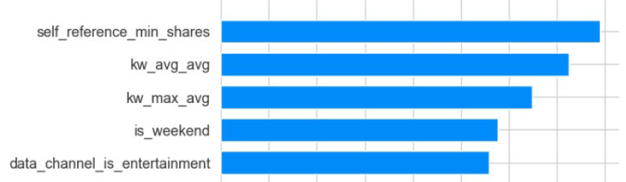
Notes:
After constructing the final model, I proceeded to take the mean SHAP values of the variables and sort them in order of importance. In other words, I extracted the top variables that are most important because they are the factors the heavily influence whether an online news article form Mashable is going to go viral or not.

Slide 19

Limitations
Notes:
There is one glaring limitation of this study.

Slide 20

Niched nature of the articles
Notes:
The niched nature of the articles.
Mashable’s customer base are mostly interested Tech, Business, and Entertainment. The fact that all the articles in the dataset are published in Mashable means that our findings would not necessarily apply to other publications that have a different kind of niche. In other words, what works well for Mashable would not necessarily translate into success for Washington Post.

Slide 21

Proposed Actions
Notes:
Nevertheless, here are a few of my recommendations for future study.

Slide 22

Discern what type of articles to publish on the weekend.
01
Use XGBoost regression on the number of shares.
02
Use clustering.
03
Notes:
First, discern what type of articles to publish on the weekend because weekend articles are more likely to go viral. If the publication has an article that they want to go viral but are not sure, they can choose to publish that article on the weekend because the guarantee that it will go viral is greater than if it were to be published during the week. Publishing during the week carries the chance of that article getting overlooked among all the noise in the news cycle.
Second, use XGBoost regression instead of a classifier. This study had set a threshold of 1400 shares and created a variable out of it. If an article has more than 1400 shares on social media, it is considered viral. If not, it is labeled as not viral. This process presents the possibility of information loss. Instead of predicting the label of viral or not, we can instead use the number of shares itself and predict it.
Third, is clustering. We can use a clustering algorithm to group or segment the articles according to a set of characteristics. Doing this can unveil some hidden patterns within the data.

Slide 23

Benefits
Notes:
There are all of things that we could in future studies. The question is, what are benefits now?

Slide 24

With feature extraction, content creators can optimize their articles.
Notes:
First and foremost, the publisher of the online news articles can take the top features and formulate the optimum combination of characteristics that they can use to optimize their articles for virality.
Second, other researchers can use the same methodology and use their own dataset to predict the virality of their content. After which, they can then extract the top factors the top features or the factors that contribute to a content going viral or not.

Slide 25
Fin.

